Slide 1
Data Science Part-time class Final Project
Andrea Kornfeld
November 15, 2018

Slide 2
Can we predict how many days it will take for a loan to get funded on Kiva?
Featured Columns:
Loan amount
Repayment terms (in months)
Sector (Agriculture, Arts, Clothing, Construction, Education, Food, Health, Housing, Manufacturing, Personal Use, Retail, Services, Transportation, Wholesale)
Country (36 countries)
Data is from Kaggle: https://www.kaggle.com/kiva/data-science-for-good-kiva-crowdfunding#loan_themes_by_region.csv

Slide 3
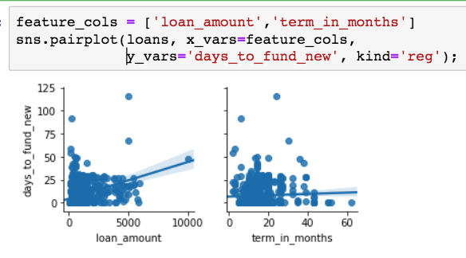
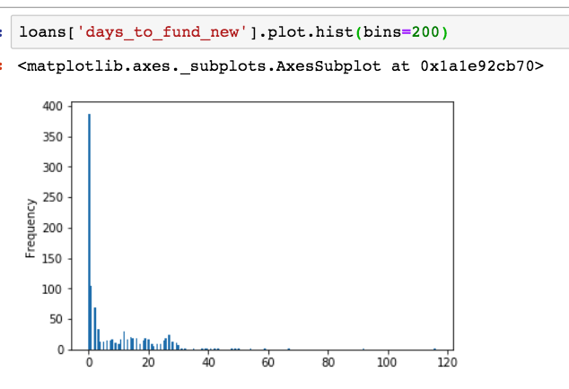
Visualizations

Slide 4
Models
Model | Featured Columns | Mean Squared Error
Linear Regression | Loan Amount | 11.14 days
Linear Regression | Loan Amount, Repayment terms | 11.15 days
Linear Regression | Loan Amount, Repayment terms, Sector | 10.92 days
Linear Regression | Loan Amount, Repayment terms, Country | 9.75 days
Linear Regression | Loan Amount, Sector, Country | 9.72 days
Standard Scaler with KNeighborsRegressors | Loan Amount, Sector, Country | 12.45 days
Standard Scaler with KNeighborsRegressors using Pipeline | Loan Amount, Sector, Country | 9.77 days
Randomized Search CV | Loan Amount, Sector, Country, Repayment terms | 7.32 days

